Slide 1
The Future of Semiconducting Materials
Lauren Kiska

Slide 2
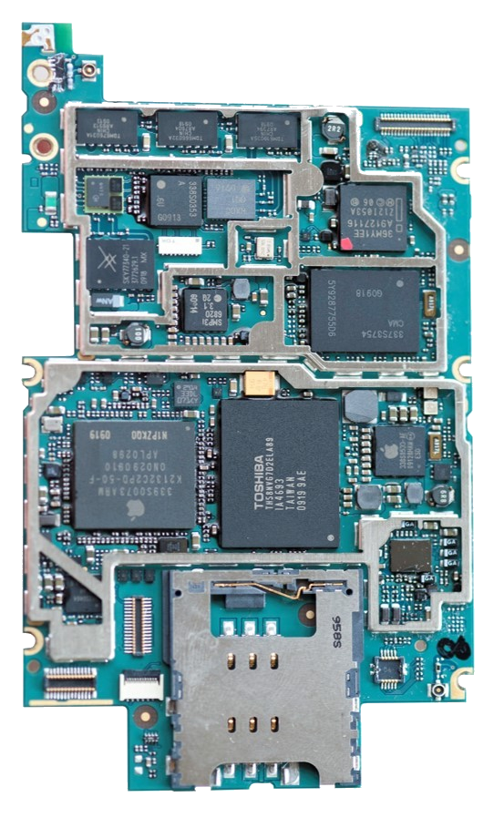
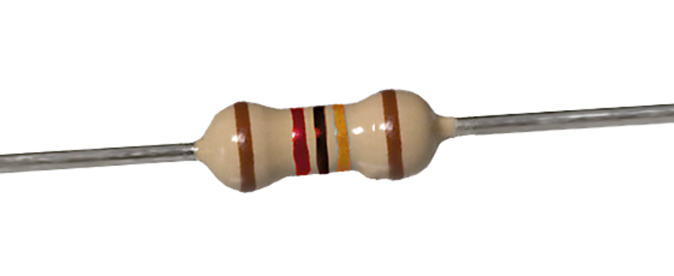
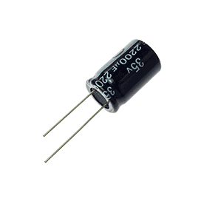
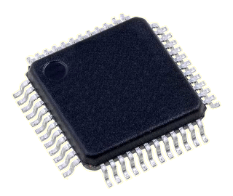


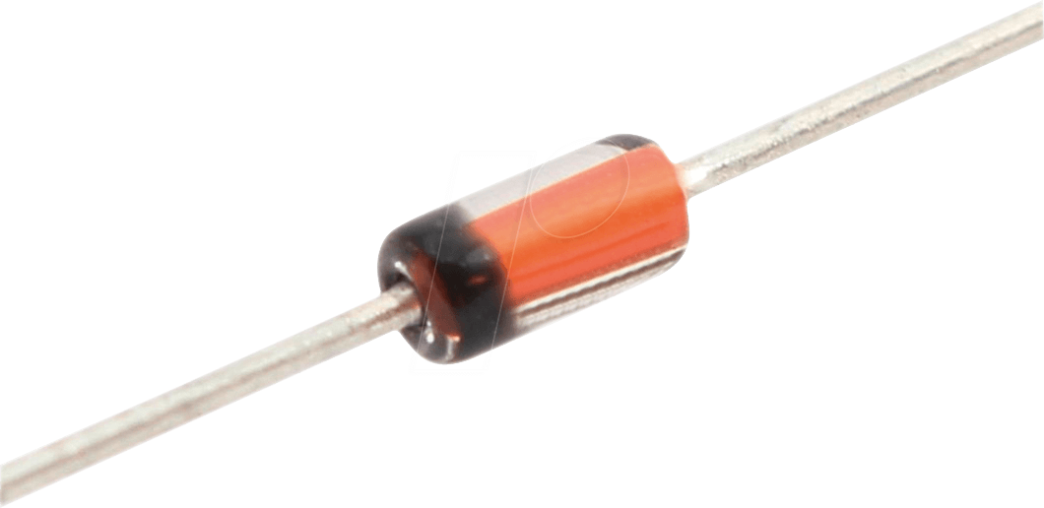
Applications
reichelt.com tandyonline.com lossenderosstudio.com amplifiedparts.com eameslighting.com nisenet.org
Notes:
Applications include resistors, transistors, capacitors, op-amps, diodes, and ICs

Slide 3
Structure
electron
hole
n-type
active area
p-type
substrate
Notes:
The structure of a typical Transition Metal Dichalcogenide (TMD) material

Slide 4
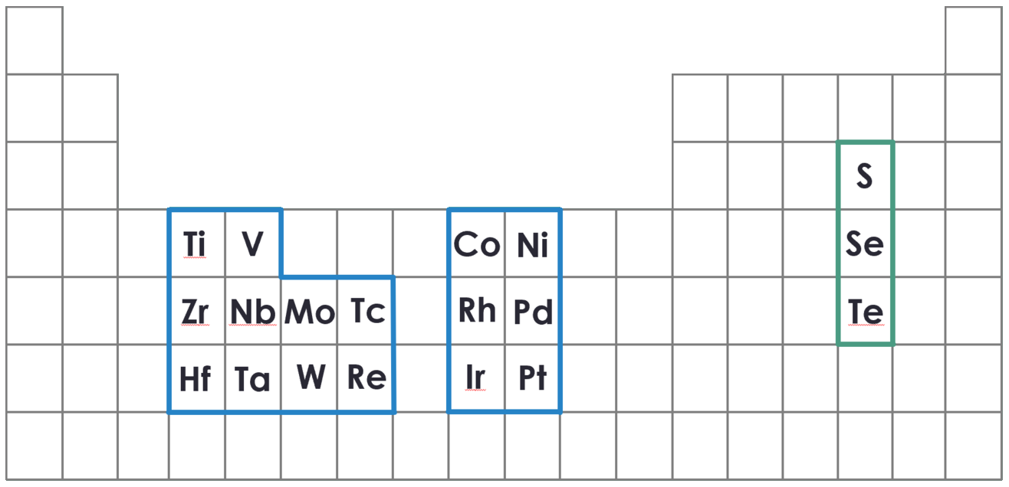
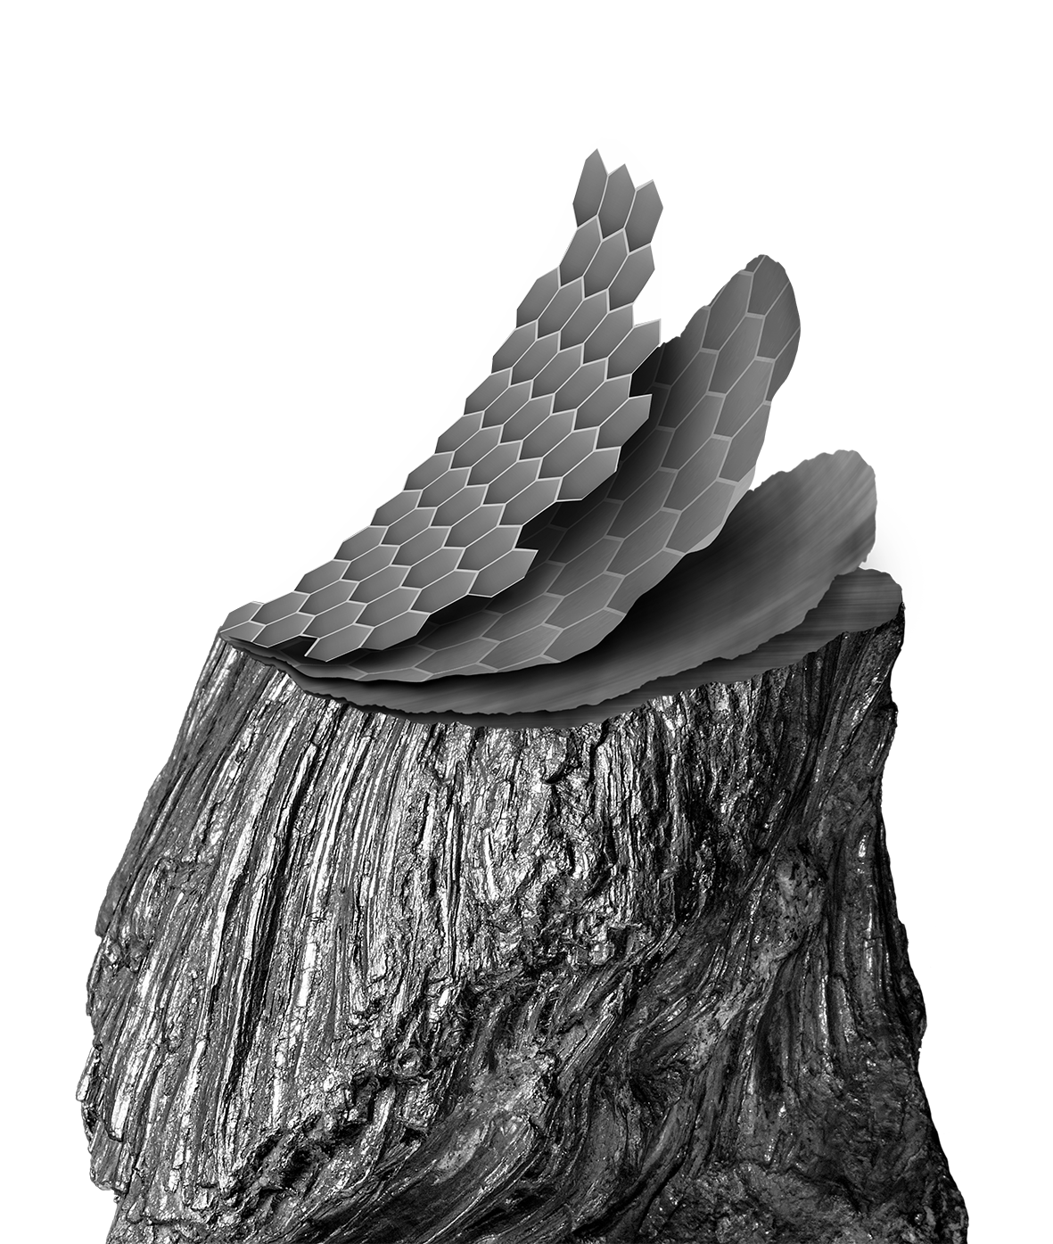
Materials
MX₂
TMDs
Graphene
graphene.ac.rs
Notes:
We compare two atomically thin semiconducting materials: graphene and TMDs

Slide 5
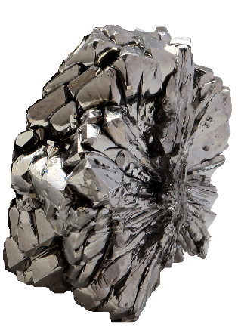
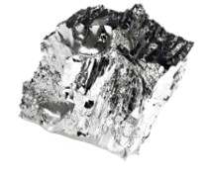
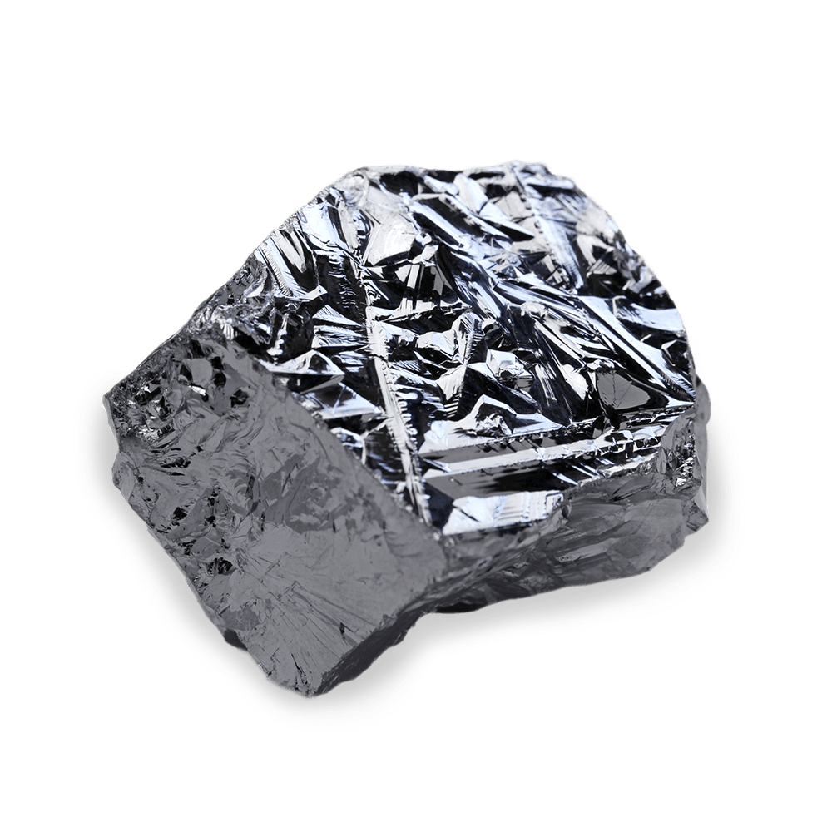
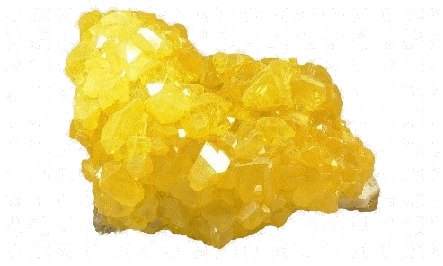
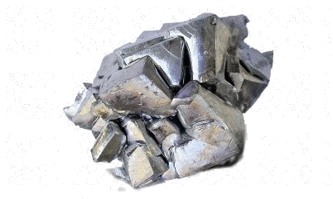
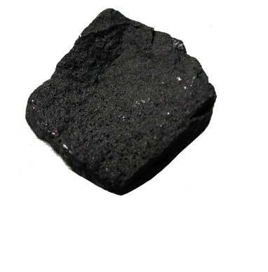
TMD Combinations
TiTe₂
MoS₂
HfSe₂
newtondesk.com theodoregray.com thorne.com kisspng.com acs.org
Notes:
Some possible TMD combinations

Slide 6
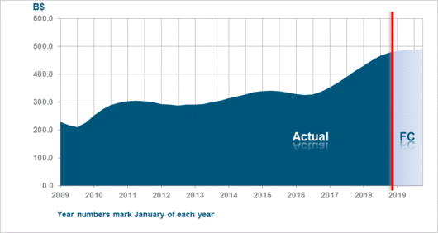
Market Trends
$468.8 billion annual sales
13.7% yearly increase
1 trillion+ units shipped
wsts.org
Notes:
Market trends for semiconductors

Slide 7
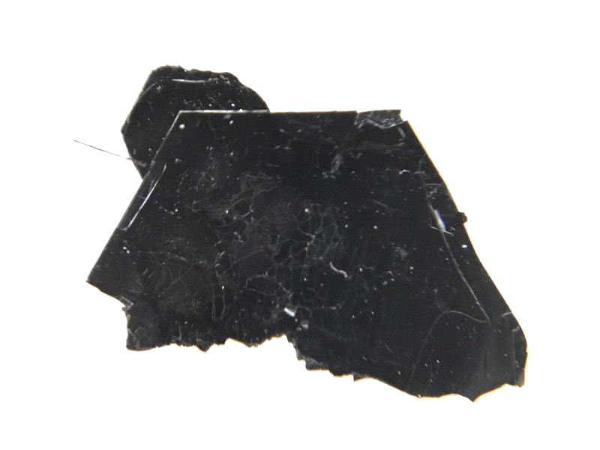
Claim
Material Requirements
Atomically thin layers
VS
Mechanical strength and flexibility
Optimum electrical properties
Uniform fabrication
graphene.ac.rs 2dsemiconductors.com
Notes:
Requirements for an atomically thin semiconductor

Slide 8
Band Gap
Metal
Semiconductor
Insulator
Fermi
Level
Band Gap
electron
Notes:
Demonstration of a band gap
No band gap = constant conduction (conductor)
Sufficiently small band gap = induced conduction (semiconductor)
Large band gap = no conduction (insulator)

Slide 9
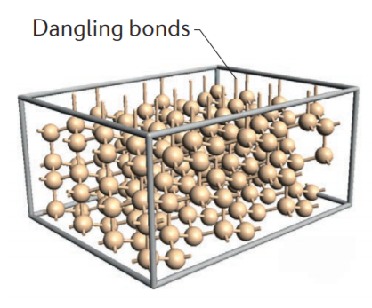
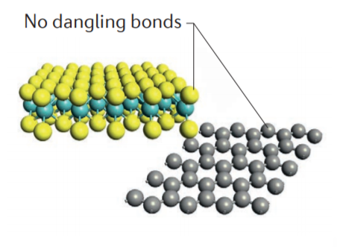
Short-Channel Effects
Wide Channel
Dangling Bonds
Quantum Tunneling
applied voltage
Narrow Channel
SPIE Journals and Proceedings
Notes:
Some issues that atomically thin TMD’s avoid

Slide 10
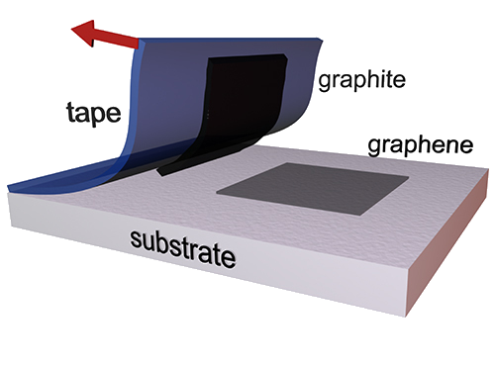
Mechanical Exfoliation
Ni
substrate
graphene
Ni
substrate
graphene.ac.rs
Notes:
How graphene nanolayers are made and how graphene is modified in order to have more desirable properties (e.g. nickel doping)

Slide 11
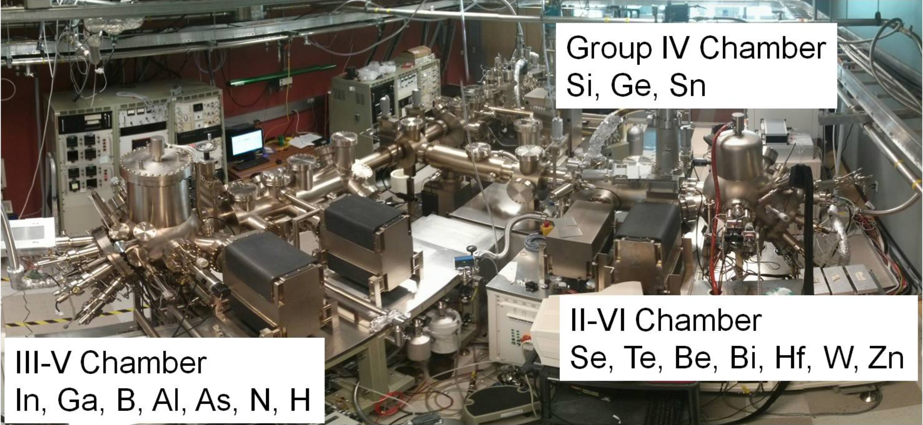
Molecular Beam Epitaxy
substrate
heated stage
dopants
M
X
substrate
utdallas.edu
Notes:
How TMDs are deposited onto a substrate

Slide 12


Conclusions and Recommendations
Graphene
TMDS
Mechanical strength and flexibility
Mechanical strength and flexibility
High electron mobility
High electron mobility
No band gap
Direct band gap
Limited electrical properties
Tunable electrical properties
Modification necessary
Mass production capabilities
2dsemiconductors.com
Notes:
TMDs recommended

Slide 13
References
[1] semiconductors.com
[2] forbes.com
[3] Chhowalla, M., et al., “Two-dimensional semiconductors for transistors”, Nature Reviews, Aug. 2016.
[4] materialstoday.com
[5] Ullman, B., Grasser, T., “Transformation: nanotechnology – challenges in transistor design and future technologies”, Elektrotechnik and Informationstechnik, 2017.
[6] Hinkle, C., et al., “HfSe₂ Thin Films: 2D Transition Metal Dichalcogenides Grown by Molecular Beam Epitaxy”, ACS Nano, 9, 2015.
[7] Yu, R., et al., “Nucleation and growth of WSe2: enabling large grain transition metal dichalcogenides”, 2D Mater., 4, Sept. 2017.

Slide 14
Contact
Lauren Kiska
Mechanical Engineering
lnk160330@utdallas.edu

